Slide 1


Data Science Capabilities PPT

Slide 2

Agenda
01
Who we are
02
What is Data science
03
Application areas
04
Application Areas
05
Data Science Life Cycle
06
Tools /Skills

Slide 3












WHO WE ARE
“ We are a core technology based solution provider who develop cutting edge technologies to support OEM's to bring their product into market quickly. ”
Over a decade of expertise in the area of wireless communication and Embedded technology.
Indian Company having branches outside.
Major clients and partners.
Diverse Service offerings in areas like PMR, Wireless Technologies, IoT and Data Analytics.
20+ Qualified professionals in Wireless and Embedded Domain
© Sigtech Wireless Technologies Pvt Ltd., 2019

Slide 4
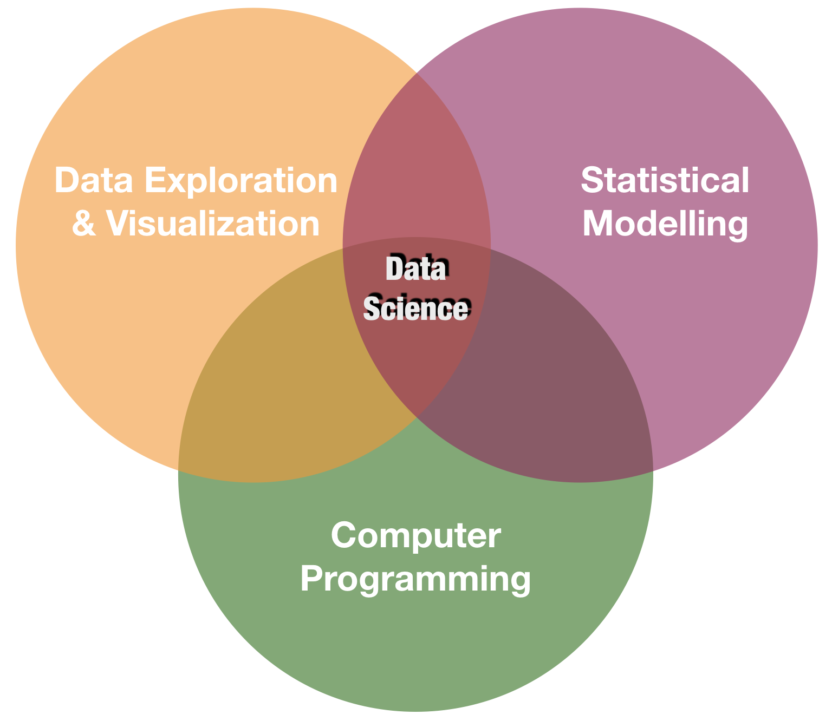
What is Data science?
Why Data science?
Is an inter disciplinary field that uses scientific methods, processes, algorithms and systems to extract knowledge and insights from structured and unstructured data.
By 2020 data driven solutions are required in every domain
We are on the way to a digital world
Large amounts of data are getting generated
Processing power becomes more
Data science
Artificial intelligence
Machine learning
Deep learning
© Sigtech Wireless Technologies Pvt Ltd., 2021

Slide 5
DATA SCIENCE LIFE CYCLE
On-Premises vs Cloud Database vs Files
Start
Business Understanding
Data Source
Pipeline
Streaming vs Batch low vs High frequency
Data Acquisition & Understanding
On-Premises vs cloud database vs data lake vs small vs medium vs big data
Transform, Binning Temporal, Text, Image, Feature Selection
Modelling
Environment
Feature Engineering
Wrangling, Exploration & Cleaning
Structured vs unstructured data validation and clean-up visualisation
Algorithms, Ensemble, Parameter Tuning, Model management, Retraining.
Model Training
Model store
Deployment
Customer Acceptance
End
Cross Validation, Model Reporting, A/B Testing
Model Evaluation
Web services
Intelligent applications
Scoring,Performance, monitoring etc,
Reference: Google images/data science life cycle
© Sigtech Wireless Technologies Pvt Ltd., 2019

Slide 6



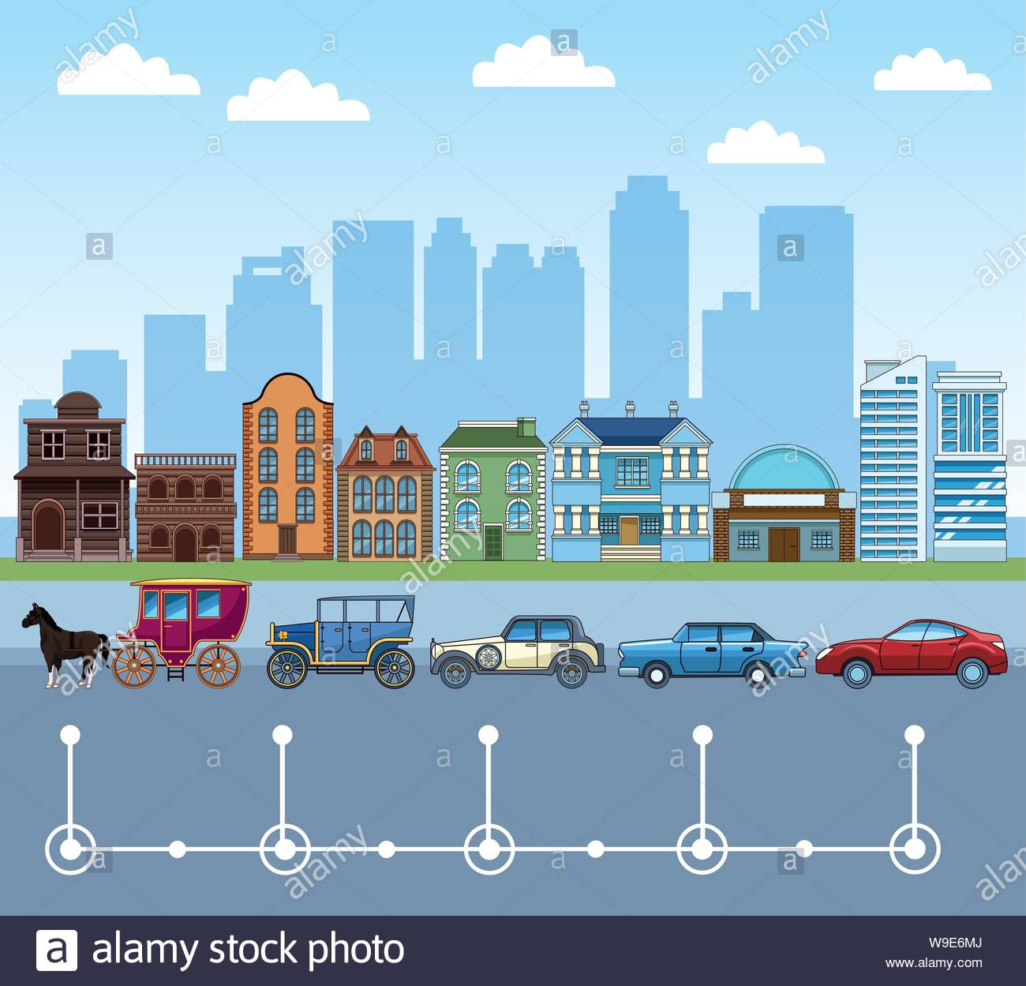


DATA SCIENCE APPLICATIONS
Identifying consumers
Recommending products
Analysing reviews
Medical image analysis
Drug delivery
Bioinformatics
Virtual assistants
E-COMMERCE
HEALTHCARE
Predicting potential problems
Monitoring systems
Automating manufacturing units
Maintenance scheduling
Anomaly detection
Self driving cars
Enhanced driving experience
Car monitoring system
Enhancing the safety of passengers
MANUFACTURING
TRANSPORT
Fraud detection
Credit risk modelling
Customer lifetime value
Customer segmentation
Strategic decision making
Risk analytics
BANKING
FINANCE
Reference: Google images/data science applications
© Sigtech Wireless Technologies Pvt Ltd., 2019
This Photo by Unknown Author is licensed under CC BY-SA-NC

Slide 7
Data Warehousing
Tools/Skills used in data science
Hadoop
Apache Spark
Pandas
Numpy
Power BI
Tableau
PythonANywhere
Skills/Tools
Data Visualisation/Deployment
Data Analysis
Python
R
Anaconda
Seaborn
Mathplotlib
Plotly &Dash
Flask
Machine learning
Tensorflow
ML
Statistics
Scikit-Learn
Pytorch
Reference: Youtube/edureka data science video
© Sigtech Wireless Technologies Pvt Ltd., 2021

Slide 8
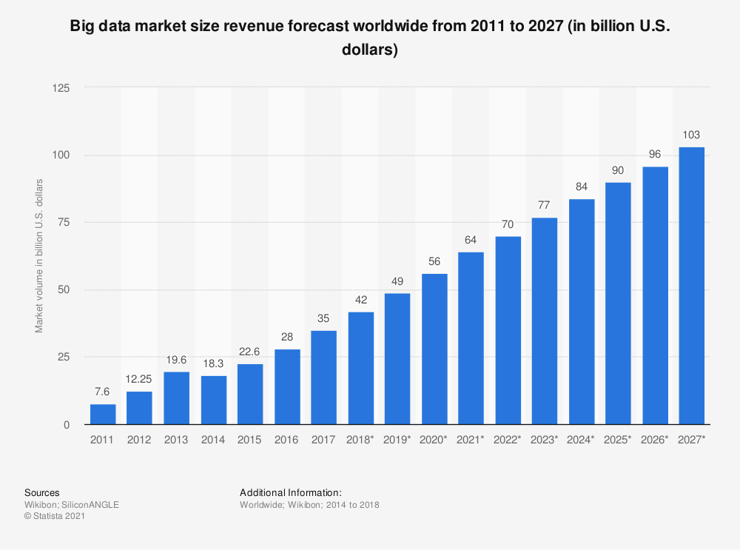
FUTURE OF DATA SCIENCE
© Sigtech Wireless Technologies Pvt Ltd., 2021

Slide 9



THANK YOU
Registered Office:
12 E, Basement Floor 1, Thejaswini, Technopark, Trivandrum, Kerala - 695 581, India
Regional Office:
68 - 43, Chongchun-dong, Bupyung-ku, Incheon, Korea
Phone: +91471 2700143 (I), +8210 8958 5775 (K)

Slide 10
Data Warehousing
Tools/Skills used in data science
Skills: ETL, SQL, Hadoop, Apache spark
Tools: Informatica/Talend, AWS Redshift
Skills/Tools
Data Visualisation
Data Analysis
Skills: R, Python libraries
Tools: Jupyter, Tableau, Cognos, RAW
Skills: R, Python, Statistics
Tools: SAS, Jupyter, R studio, MATLAB, Excel, Rapidminer
Machine learning
Skills: Algebra, ML Algorithms, Statistics
Tools: Spark Mlib, Mahout, Azure ML studio
© Sigtech Wireless Technologies Pvt Ltd., 2021

